Slide 1

.NET Full Stack AI Enabled Developers
Trainer: Nikhil Shah

Slide 2
Agenda
Introduction
About the trainer
About You
About the training Sessions
What you will learn
Topics and tools
Guidelines and suggestions from trainer
What you achive

Slide 3
Introduction - Audience
Name
Describe yourself technically – experience, framework, work, task, projects etc.
Technical Background
What I already Know
What I want to learn
Expectations from the training

Slide 4
Day 1
Introduction to .Net
.Net Framework vs .Net Core
Tools to be used
Download and Install
Your First .net Core Program / Application
Introduction to C# and Programming
Way ahead – week ahead plan
Introduction to GIT
Create a new Git Account
Your First GIT Repository
Reads, Research and make notes

Slide 5
.Net Framework
.NET is a framework to develop software applications. It is designed and developed by Microsoft and the first beta version released in 2000.
It is used to develop applications for web, Windows, phone. Moreover, it provides a broad range of functionalities and support.
This framework contains a large number of class libraries known as Base Class Library (BCL). The software programs written in .NET are executed in the execution environment, which is called CLR (Common Language Runtime). These are the core and essential parts of the .NET framework.
This framework provides various services like memory management, networking, security, memory management, and type-safety.

Slide 6
.Net Framework Components
The .Net Framework supports more than 60 programming languages such as C#, F#, VB.NET, J#, VC++, JScript.NET, APL, COBOL, Perl, Oberon, ML, Pascal, Eiffel, Smalltalk, Python, Cobra, ADA, etc.
The .NET Framework is composed of four main components:
Common Language Runtime (CLR)
Framework Class Library (FCL),
Core Languages (WinForms, ASP.NET, and ADO.NET), and
Other Modules (WCF, WPF, WF, Card Space, LINQ, Entity Framework, Parallel LINQ, Task Parallel Library, etc.)

Slide 7
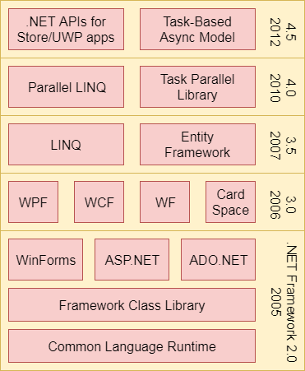

Slide 8
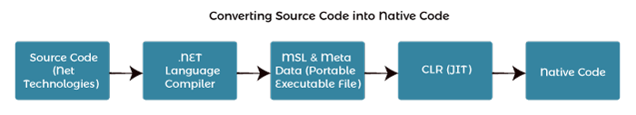
CLR (Common Language Runtime)
It is a program execution engine that loads and executes the program. It converts the program into native code. It acts as an interface between the framework and operating system.
It does exception handling, memory management, and garbage collection. Moreover, it provides security, type-safety, interoperability, and portablility. A list of CLR components are given below:

Slide 9
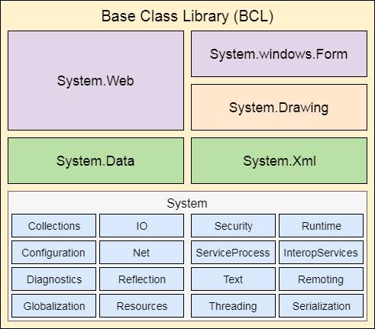
FCL (Framework Class Library)
It is a standard library that is a collection of thousands of classes and used to build an application. The BCL (Base Class Library) is the core of the FCL and provides basic functionalities.
Notes:
https://www.javatpoint.com/net-common-language-runtime

Slide 10
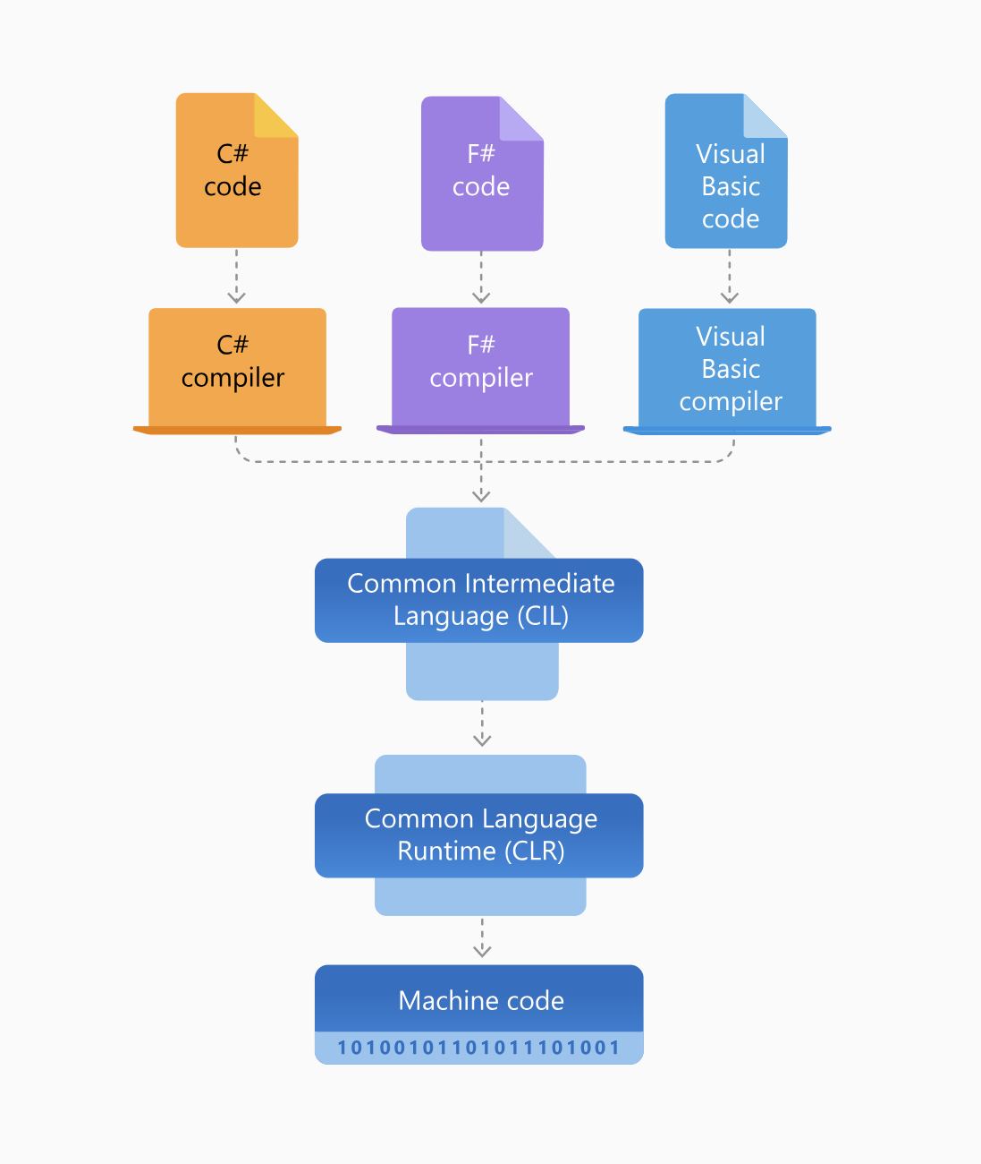
Architecture of .NET Framework
Byte code in java
JVM in java

Slide 11
Scale Up
Further Read
https://learn.microsoft.com/en-us/dotnet/framework/get-started/
Must go through
https://interviewprep.org/net-framework-interview-questions/

Slide 12

.NET Core
.NET Core is a new version of .NET Framework, which is a free, open-source, general-purpose development platform maintained by Microsoft. It is a cross-platform framework that runs on Windows, macOS, and Linux operating systems.
.NET Core can be used to build different types of applications such as mobile, desktop, web, cloud, IoT, machine learning, microservices, game, etc.
.NET Core is written from scratch to make it modular, lightweight, fast, and cross-platform Framework. It includes the core features that are required to run a basic .NET Core app. Other features are provided as NuGet packages, which you can add it in your application as needed. In this way, the .NET Core application speed up the performance, reduce the memory footprint and becomes easy to maintain.

Slide 13

Why .NET Core?
There are some limitations with the .NET Framework. For example, it only runs on the Windows platform.
Also, you need to use different .NET APIs for different Windows devices such as Windows Desktop, Windows Store, Windows Phone, and Web applications.
In addition to this, the .NET Framework is a machine-wide framework. Any changes made to it affect all applications taking a dependency on it.

Slide 14
.NET Core Characteristics
Open-source Framework: .NET Core is an open-source framework maintained by Microsoft and available on GitHub under MIT and Apache 2 licenses. It is a .NET Foundation project.
Cross-platform: .NET Core runs on Windows, macOS, and Linux operating systems. There are different runtime for each operating system that executes the code and generates the same output.
Consistent across Architectures: Execute the code with the same behavior in different instruction set architectures, including x64, x86, and ARM.
Wide-range of Applications: Various types of applications can be developed and run on .NET Core platform such as mobile, desktop, web, cloud, IoT, machine learning, microservices, game, etc.
Supports Multiple Languages: You can use C#, F#, and Visual Basic programming languages to develop .NET Core applications. You can use your favorite IDE, including Visual Studio 2017/2019, Visual Studio Code, Sublime Text, Vim, etc.
Modular Architecture: .NET Core supports modular architecture approach using NuGet packages. There are different NuGet packages for various features that can be added to the .NET Core project as needed. Even the .NET Core library is provided as a NuGet package. The NuGet package for the default .NET Core application model is Microsoft.NETCore.App.

Slide 15
.NET Core Characteristics
CLI Tools: .NET Core includes CLI tools (Command-line interface) for development and continuous-integration.
Flexible Deployment: .NET Core application can be deployed user-wide or system-wide or with Docker Containers.
Compatibility: Compatible with .NET Framework and Mono APIs by using .NET Standard specification.
High Performance: .NET Core was optimized for performance, with features like Just-In-Time (JIT) compilation, which translated code into machine instructions at runtime for better execution speed.
Unified Platform: After .NET Core 3.1, Microsoft unified the .NET platforms, bringing together .NET Core, .NET Framework, and Xamarin into a single platform called ".NET" starting from .NET 5. This unified platform aimed to provide consistent APIs and runtime behavior across different application types.

Slide 16

First .Net Core Program
Tools
.Net Core - https://dotnet.microsoft.com/en-us/download
. Net Core CLI – Command Line Interface – Included with above download
Visual Studio Code - https://visualstudio.microsoft.com/downloads/

Slide 17

Steps
1. Create new folder – Cohort05082024
You will create a new folder in this folder everyday – Day1, Day2, Day3 etc
Open Visual Studio code and point it to day 1
Control + ~ to bring the terminal, make sure terminal shows path to day1
First Project
dotnet new console –name firstcoreapp
Cd firstcoreapp
dotnet build
dotnet run

